Slide 1
Parallel And Distributing Computing
Muhammad Talha Ilyas
Ali Jarrar Haider
Shahzaib Ali

Slide 2
Introduction Of Parallel Algorithm Models
The models of parallel algorithms are developed by considering a strategy for dividing the data and processing method and also applying a suitable strategy to reduce interaction. Following are some types of parallel algorithm models
Data Parallel Model
Task Graph Model
Work Pool Model
Master Slave Model
Producer Consumer Model/Pipleline Model
Hybrid Model

Slide 3
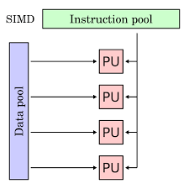
Data Parallel Model
The tasks are assigned to processes and each task perform similar type of operations on different data .In this way data parallelism is achieved by applying single operation on multiple data.
It is similar to SIMD(Single Instruction Multiple Data).
This model use message passing mechanism.
This model had single address space.

Slide 4
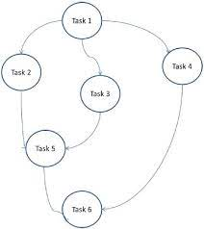
Task Graph Model
In this model different problems are divided in to different tasks to implement a graph.
Each task is independent unit but it has dependence with its predecessor task because after completion of one task the output is transferred to its dependent task.
Dependent start execution only when its antecedent task finish execution.
The graph may be trivial or non-trivial.

Slide 5
Work Pool Model
In this model the task are assigned among processes to balance the load.
Any process can execute any task.
In this model the operations are large while data is small.
The assigning of task can be categorized or un-categorized.
Hash table or tree queue is used to store pointers.
Generation of processes can also be dynamic.
P 1
P 2
Work
P 3
P 4

Slide 6
Master Slave Model
In this model there exists one or more master process that generate tasks and assign them to slave processes.
Master can estimate the number of operations.
Slaves are assigned smaller tasks.
This model use message passing technique and shared address space.
One master process can assign task to slave master and further to slave too.
Master
Slave
Slave
Slave

Slide 7
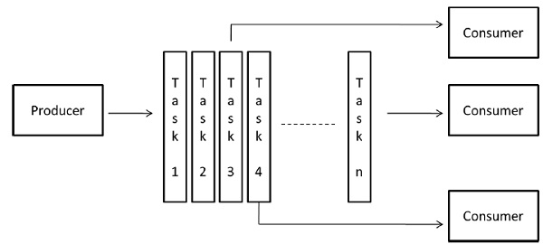
Pipeline Model
It is also known as producer consumer model.
In this model data is passed through series of processes.
New data generate new task that is to be performed by the process in the queue.
A queue is built by using array , graph ,tree etc.
Processes are consumer while data is producer

Slide 8
Basic Communication Operations
Many interactions in practical parallel programs occur in well defined patterns involving groups of processors.
Efficient implementations of these operations can improve performance, reduce development effort and cost, and improve software quality.
Efficient implementations must leverage underlying architecture. For this reason, we refer to specific architectures here. select a descriptive set of architectures to illustrate the process of algorithm design.

Slide 9
All To One Reduction
One processor has a piece of data (of size m) it needs to send to everyone.
The dual of one-to-all broadcast is all-to-one reduction.
In all-to-one reduction, each processor has m units of data.
These data items must be combined piece-wise (using some associative operator, such as addition or min), and the result made available at a target processor.
The message/nodes combined and reduced to one message /node.
123
1
2
3

Slide 10
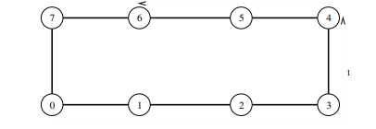
Eight Node Ring Example
The first node will transfer the message to the node having maximum distance.
Then the nodes who have received the message send it to the nodes having distance half of the maximum.
Then again the nodes who have the message further send it by again hal the distance.
{1-5}
{1-3; 5-7}
{1-2;3-4;5-6;7-8}

Slide 11
One to All Broadcasting
In one to all broadcasting the node or the message which is reduced got broadcasting to all nodes.
It is basically opposite to one to all reduction.
1
1
1
1
1
1
1

Slide 12
Eight Node Ring Example
The nodes will transfer the message to their immediate node with minimum distance.
Then again nodes will transfer the message to nodes with distance more then minimum.
Then the nodes transfer message to nodes having maximum distance.
{2-1;4-3;6-5;8-7}
{7-5;3-1}
{5-1}

Slide 13
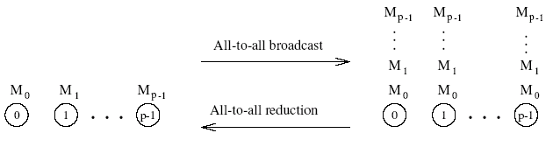
All To All BroadCast &Reduction
Generalization of broadcast in which each processor is the source as well as destination.
A process sends the same m-word message to every other process, but different processes may broadcast different messages.

Slide 14
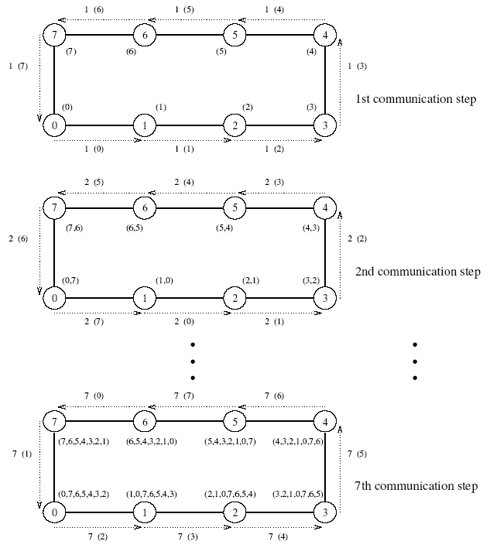
Eight Node Ring Example

Slide 15
All To All Reduction
Similar communication pattern to all-to-all broadcast, except in the reverse order.
On receiving a message, a node must combine it with the local copy of the message that has the same destination as the received message before forwarding the combined message to the next neighbor.

Slide 16
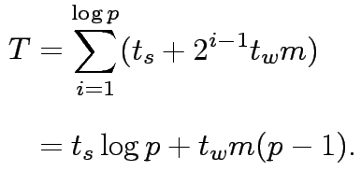
Cost Analysis
Following are the formulas to calculate cost.
On a ring, the time is given by: (t_{s} + t_{w}m)(p-1).
On a mesh, the time is given by: 2t_{s}(√p – 1) + t_{w}m(p-1).
On a hypercube, we have:
Here Ts is serial run time , Tp is parallel run time while p is number of processing elements

